Slide 1
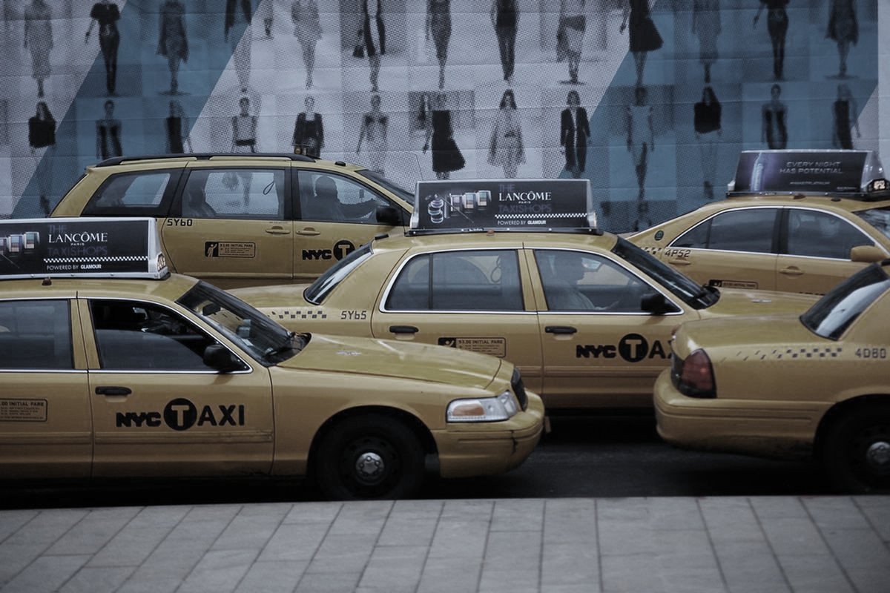
PREDICTION OF TAXI FARE USING EXPLORATORY ANALYSIS
TEAM NO:10
S.KIRTHANA GOMATHY K.AISHWARIYA
P.PRINCY

Slide 2
PROBLEM STATEMENT:
To predict the fare charges by considering the given datasets.
To predict the fare charges depending upon the time and distance between the pickup and drop location
And to predict the fare values with best accuracy rate.

Slide 3
ABSTRACT
The aim of this project is to predict the taxi fare :
By getting the data – date and time (i.e either future or present) it predicts the taxi fare which includes factors like peak hours, week days, distance etc,
The distance and time can be calculated using mathematical formulae.(Haversine formula)
The algorithm used here is k-Nearest Neighbor (KNN)
Furthermore, to achieve our goal, we proposed our subsequent analysis i.e. Analysis on Region. Here we accumulate information which was allied with location like Pickup Latitude, Pickup Longitude, Drop-off Latitude and Drop-off Longitude.
FORMULA USED:
1.a = sin²(Δφ/2) + cos φ1 ⋅ cos φ2 ⋅ sin²(Δλ/2)
2.c = 2 ⋅ atan2( √a, √(1−a) )
3.d = R ⋅ c (where R= radius of the earth=6371km)

Slide 4
OBJECTIVE
The goal of this project is to predict the fare of a taxi trip , by using the information's like pickup and drop off locations, the pickup date , time and number of passengers travelling.
This system can also predict the taxi fare for future days by getting date as an input.

Slide 5
EXISTING MODEL
The existing model uses random forest regression. A random forest model does not scale very well for time-series data and might need to be constantly updated or trained with some random data that lies outside the range of training set.

Slide 6
PROPOSED SYSTEM
Here we have used KNN (k-nearest neighbor)model.we have used this algorithm because it is
1.Easy to calculate time
2.Easy to predict the output.
Here we have used time to calculate the fare amount in addition to distance.
LIMITATIONS:
We can book only within particular range(ie.latitude and longitude).we cannot book the taxi beyond the limit.

Slide 7
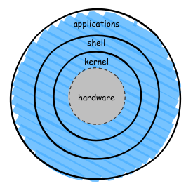
Architecture
The architecture used here is:
HARDWARE: Consist of (CPU/RAM/HDD)
KERNEL: Core component of OS low level
service to layer component. ,It also decides
when and how long a program should run.
APPLICATION: (colab) where the program is
runned and executed.

Slide 8
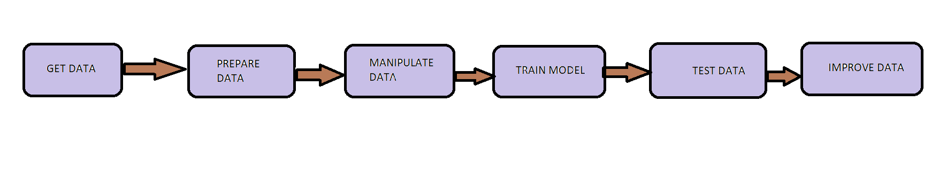
LIST OF MODULES:

Slide 9
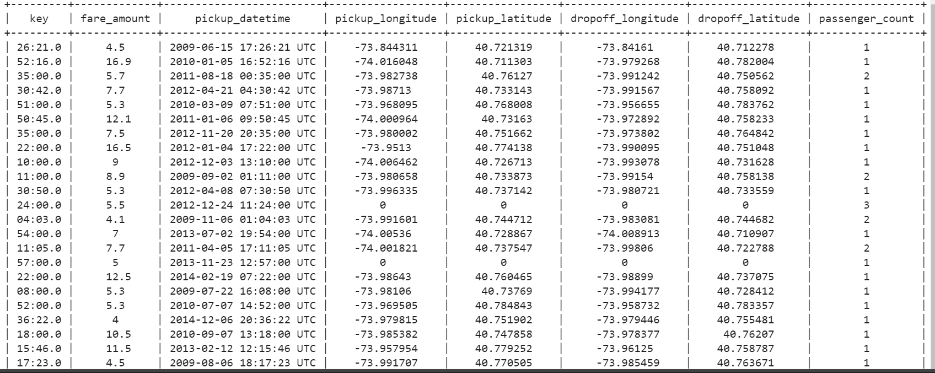
dataSet

Slide 10
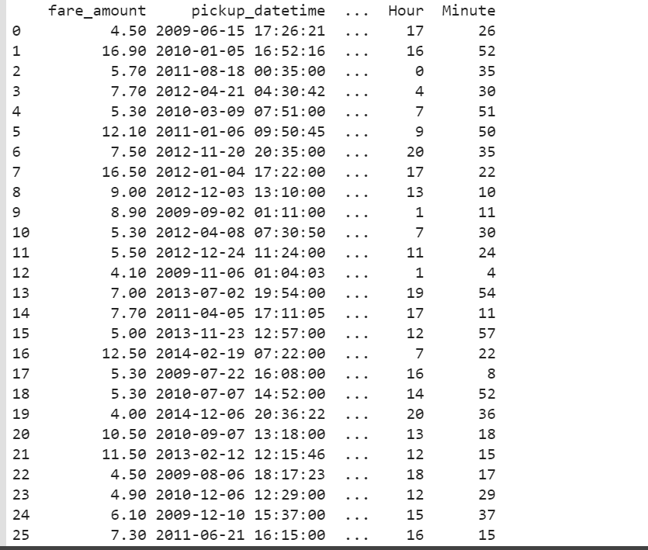
Splitting of TIME

Slide 11
conclusion
In this system we can predict the fare amount in future. Considering what is and what is not accounted for in the model is their predicting results are fairly accurate. And in future to improve the prediction accuracy, more variabilities need to be considered and modeled. It can be said that in more affluent parts of the city and during peak hours, a higher percentage tip will be paid to any taxi driver. Hopefully with this information, taxi drivers can better plan their routines for the day in order to increase their own earnings.

Slide 12
REFERENCE
[1] Fare and Duration Prediction: A Study of New York City Taxi Rides Christophoros Antoniades, Delara Fadavi, Antoine Foba Amon Jr. December 16, 2016
[2] Competition : New York City Taxi Fare Prediction (https://www.kaggle.com/c/new-york-city-taxi-fare-prediction) by Kuldeep Patel.
[3] How Taxis Arrive at Fares? -Predicting New York City Yellow Cab Fares by Susan Li.
[4]Vanajakshi, L., S. C. Subramanian, and R. Sivanandan. "Travel time prediction under heterogeneous traffic conditions using global positioning system data from buses." IET intelligent transport systems 3.1 (2009): 1-9.
[5] NYC Taxi Trip and Fare Data Analytics using Big Data Umang Patel Department of Computer Science and Engineering University of Bridgeport, USA.

Slide 13
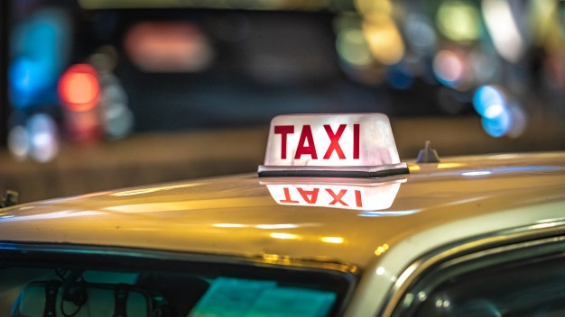
THANK YOU

